Slide 1
Revenue, Operation, and Device Optimization Model (RODeO)
Model Details
Name: RODeO (Revenue, Operation, and Device Optimization)
Purpose: Fixed-price optimization
Temporal Resolution: typically 5min to 1 hr but can be adjusted
Temporal Scope: From 1 month to 3 years
Spatial Resolution: single location (node/region/etc.)
Spatial Scope: single location (node/region/etc.) can include many devices but all are aggregated under one node for wholesale or retail price calculations
System scope: Simulates participation in wholesale and retail, electric and gas markets
Modeling paradigm: Optimization
Major processes modeled: Revenue maximization
Uncertainty treatment: Scenarios
Computational scalability: Model typically runs fast (30sec – 5 min) and it can be run in parallel
Use of HPC: Possible
Primary development organization: NREL
Source Language: GAMS
Platform: Cross-platform
License: Exploring open-sourcing
Source: Lab-developed
Dataset restrictions: None
NREL PI: Joshua.Eichman@NREL.gov
Link: https://github.nrel.gov/jeichman/RODeO
Islanded
Separated
Retail
Hybrid
Retail+NEM
Wholesale
Prior Applications
Multi-market optimization, Wholesale market revenue comparison, Hydrogen business case assessment, Retail rate optimization, Off-shore wind farm revenue, PV+Storage, Real-time optimization control of electrolyzer, Fleet-wide EV bus optimization optimization
Research questions:
How should a device(s) operate to maximize revenue. With a focus on storage and flexible loads (i.e., electric vehicles, electrolyzer)?
Is a device economically competitive?
How to optimally stack multiple value streams?
Client and stakeholder involvement: DOE, CARB, PG&E, GO-Biz, EPRI

Slide 2
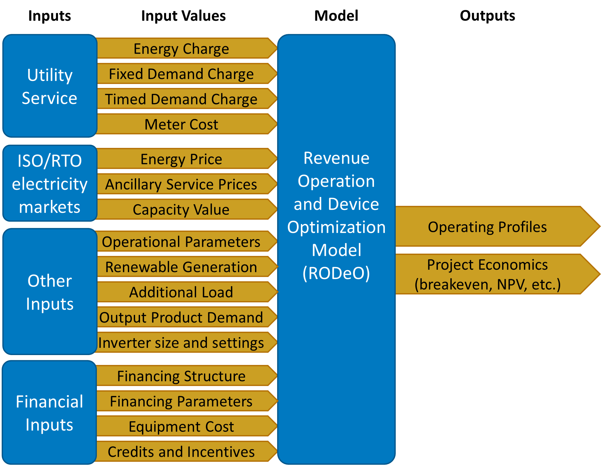
Revenue, Operation, and Device Optimization Model (RODeO)
Model Details
Name: RODeO (Revenue, Operation, and Device Optimization)
Purpose: Fixed-price optimization
Temporal Resolution: typically 5min to 1 hr but can be adjusted
Temporal Scope: From 1 month to 3 years
Spatial Resolution: single location (node/region/etc.)
Spatial Scope: single location (node/region/etc.) can include many devices but all are aggregated under one node for wholesale or retail price calculations
System scope: Simulates participation in wholesale and retail, electric and gas markets
Modeling paradigm: Optimization
Major processes modeled: Revenue maximization
Uncertainty treatment: Scenarios
Computational scalability: Model typically runs fast (30sec – 5 min) and it can be run in parallel
Use of HPC: Possible
Primary development organization: NREL
Source Language: GAMS
Platform: Cross-platform
License: Exploring open-sourcing
Source: Lab-developed
Dataset restrictions: None
NREL PI: Joshua.Eichman@NREL.gov
Link: https://github.nrel.gov/jeichman/RODeO
Prior Applications
Multi-market optimization, Wholesale market revenue comparison, Hydrogen business case assessment, Retail rate optimization, Off-shore wind farm revenue, PV+Storage, Real-time optimization control of electrolyzer, Fleet-wide EV bus optimization optimization
Research questions:
How should a device(s) operate to maximize revenue. With a focus on storage and flexible loads (i.e., electric vehicles, electrolyzer)?
Is a device economically competitive?
How to optimally stack multiple value streams?
Client and stakeholder involvement: DOE, CARB, PG&E, GO-Biz, EPRI

Slide 4
Summary
The Revenue, Operation, and Device Optimization (RODeO) model explores optimal system design and operation considering different levels of grid integration, equipment cost, operating limitations, financing, and credits and incentives. RODeO is a price-taker model formulated as a mixed-integer linear programming (MILP) model in the GAMS modeling platform. The objective is to maximizes the net revenue for a collection of equipment at a given site. The equipment includes generators (e.g., gas turbine, steam turbine, solar, wind, hydro, fuel cells, etc.), storage systems (batteries, pumped hydro, gas-fired compressed air energy storage, long-duration systems, hydrogen), and flexible loads (e.g., electric vehicles, electrolyzers, flexible building loads). The input data required by RODeO can be classified into three bins. 1). utility service data, which refers to retail utility rate information (meter cost, energy and demand charges). 2). Electricity market data, which include energy and reserve prices. 3) other inputs, which refer to additional electrical demand, product output demand, technological assumptions, financial properties, and operational parameters.

